Slide 1
sddec20-19
Automated Team Attendance Tool
Final Project Review Spring 2020
Angela Schauer, Brandon Johnson, Nathan Oran, Lance Demers, Connor Sullivan

Slide 2
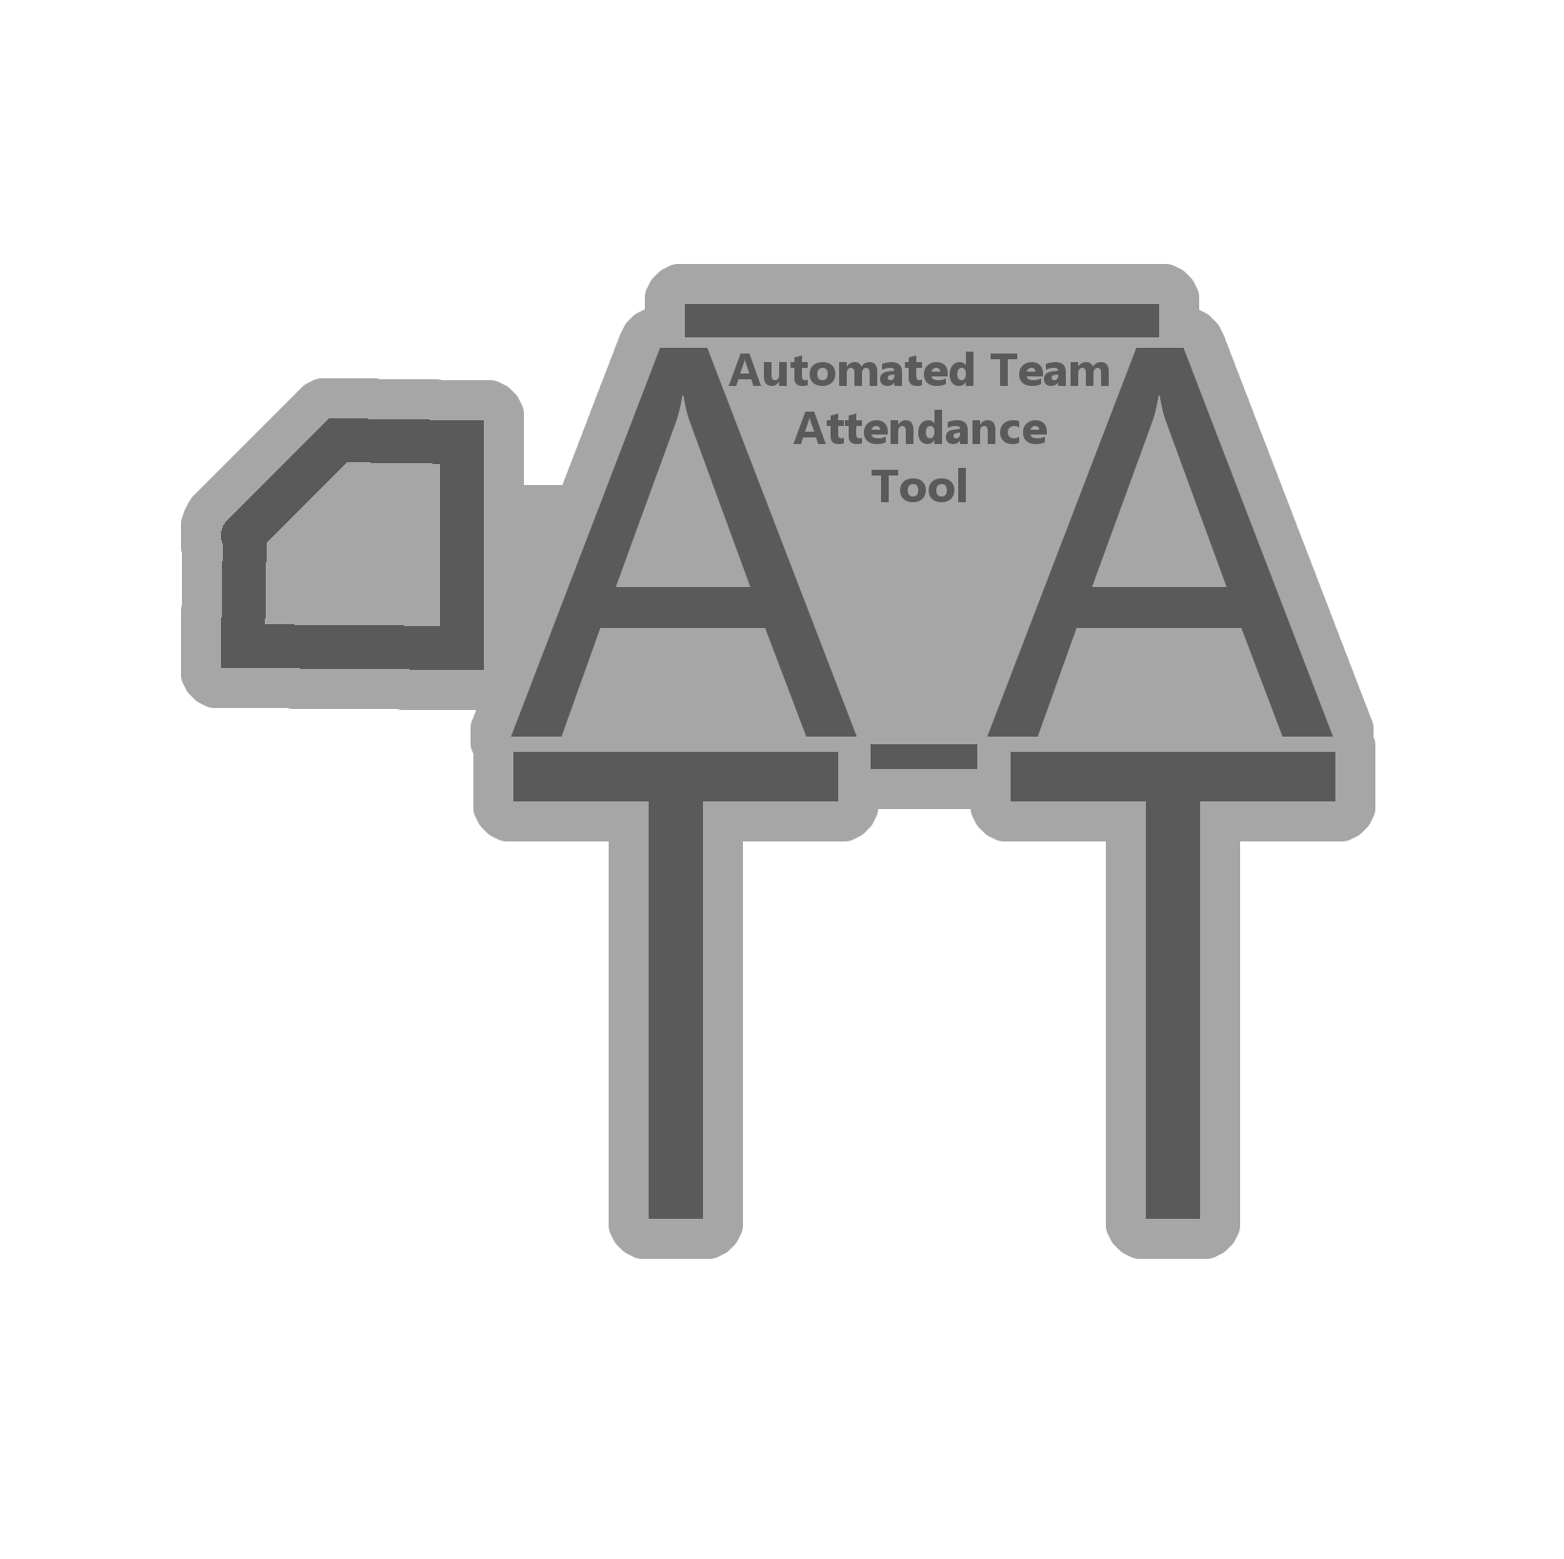
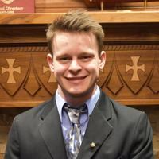
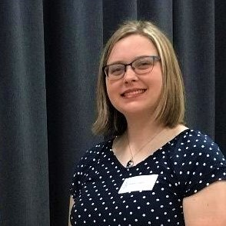
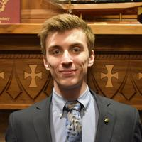
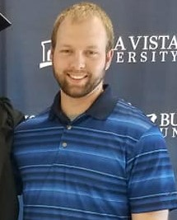
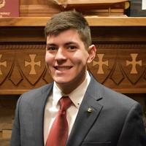
Our Team
Connor Sullivan
Software Engineering
Angela Schauer
Software Engineering
Brandon Johnson
Electrical Engineering
Lance Demers
Computer
Engineering
Nathan Oran
Computer Engineering
Notes:
Brandon Johnson

Slide 3
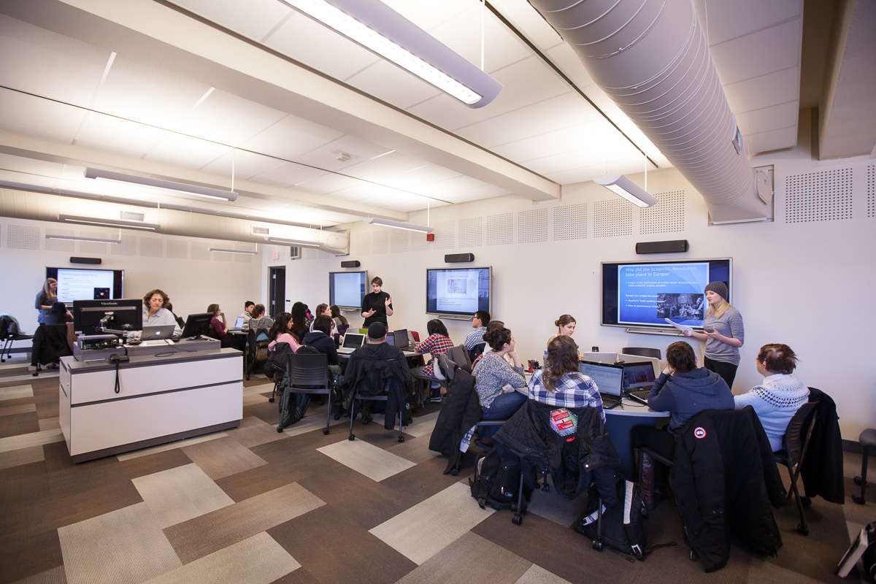
Problem Statement
What is Team-Based Learning (TBL)?
Instead of the traditional lecture, students collaborate and learn from each other in addition to the instructor.
Brandon

Slide 4
Problem Statement
For TBL classes to succeed it is invaluable that all team members show up.
Taking attendance can take a good portion of class time
Even with using tools to help speed it up it takes about 5 minutes
Which over a whole semester would be about one whole class period
Brandon

Slide 5
Project Concept
We want to be able to take attendance of team based learning classes automatically.
Taking attendance manually can be very tedious for even the smallest classes, and it can take up valuable class time. There are resources available, but they require some sort of interaction from the professor or students.
We will use a raspberry pi with a camera and object detection software, YOLO, to capture attendance.
Lance

Slide 6
Automated Team Attendance Tool
Fully automatic attendance evaluation system
Tailored to Team-Based Learning classrooms
Will use a mounted camera to take pictures of the classroom
Use YOLO, an object detection tool, to identify the location of students
Use a supplied seating chart to determine which students belong to which team
Compile a report of which teams are missing members
Email the attendance report to the class instructor
Lance
Notes:
As the name implies, [name], or ATAT, is a...

Slide 7
Requirements
Hardware Requirements:
Run on Raspberry Pi
Use a camera to take clear pictures
Mounted such that the camera has full visibility of the classroom
Software Requirements:
Control and receive pictures from the camera
Accurately detect the students within the taken picture
Determine which teams are missing members
Consolidate the attendance and send the report to the professor
Allow the professor the create and adjust multiple seating charts for use in the system
Connor

Slide 8
Design Overview
Attendance Evaluator
Responsible for processing images into attendance reports
Scheduler
Responsible for calling the Attendance Evaluator to run at the proper class times, and sending the reports to the professor
YOLO v3
Object Detection tool of choice
Camera
Raspberry Pi Camera Module V2
Seating Chart DB
Stores class seating chart information for each class
Connor

Slide 9
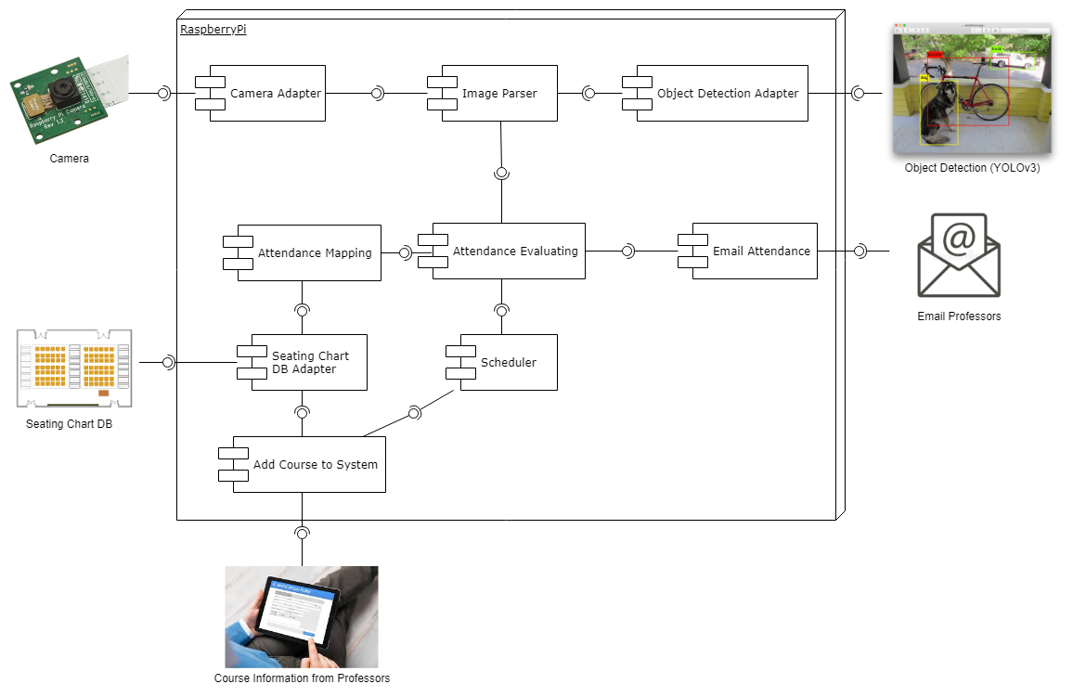
Component Diagram
Angela
Notes:
Angela

Slide 10
YOLO
Object detection software
Applies single neural network to full image
Divides into regions and predicts weighted bounding boxes
Open source, easy to train, easy to implement
Angela
Notes:
Angela

Slide 11
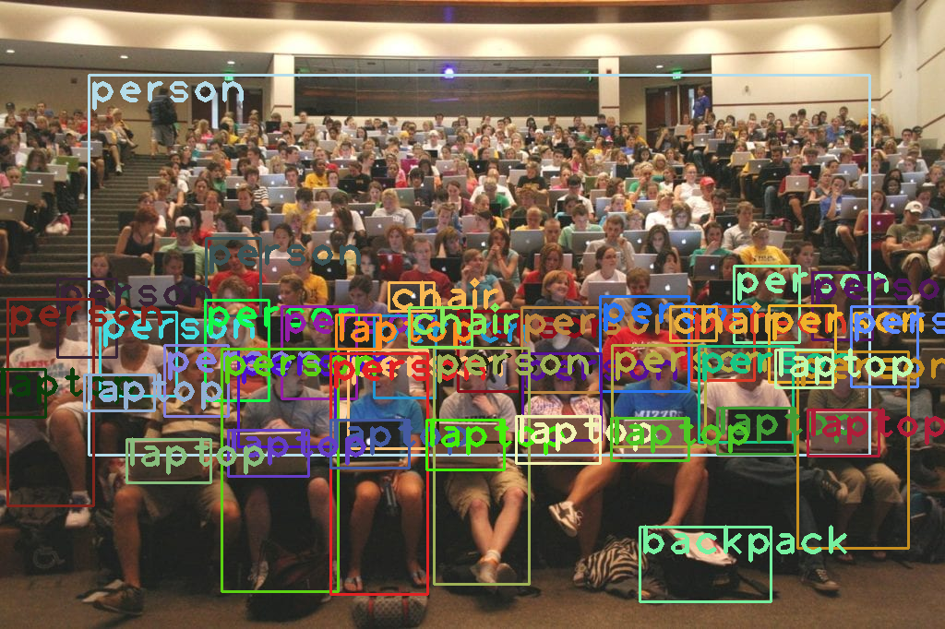
YOLO Challenge
Problem: Tightly grouped students are hard to identify
Solution: Split image into smaller images and run the software
Angela
Notes:
Angela

Slide 12
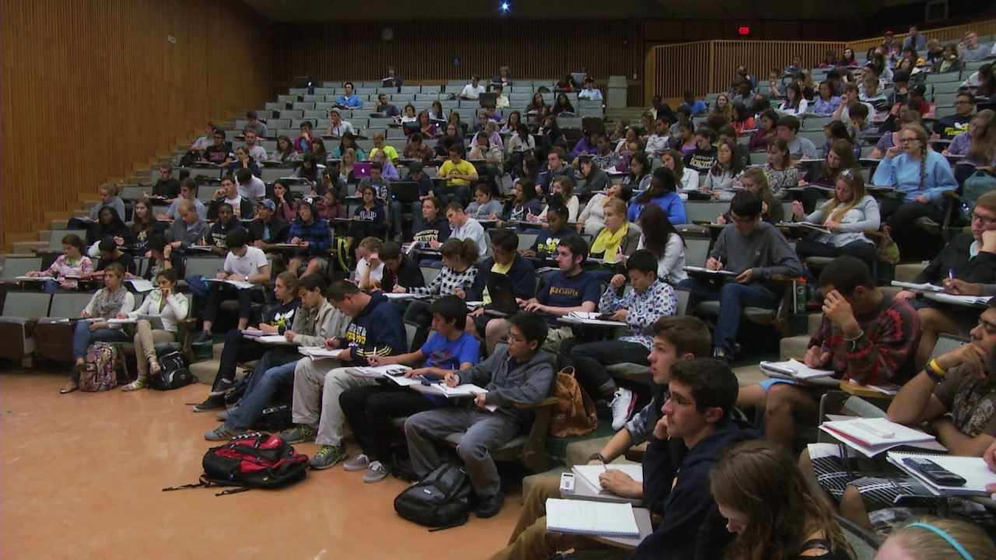
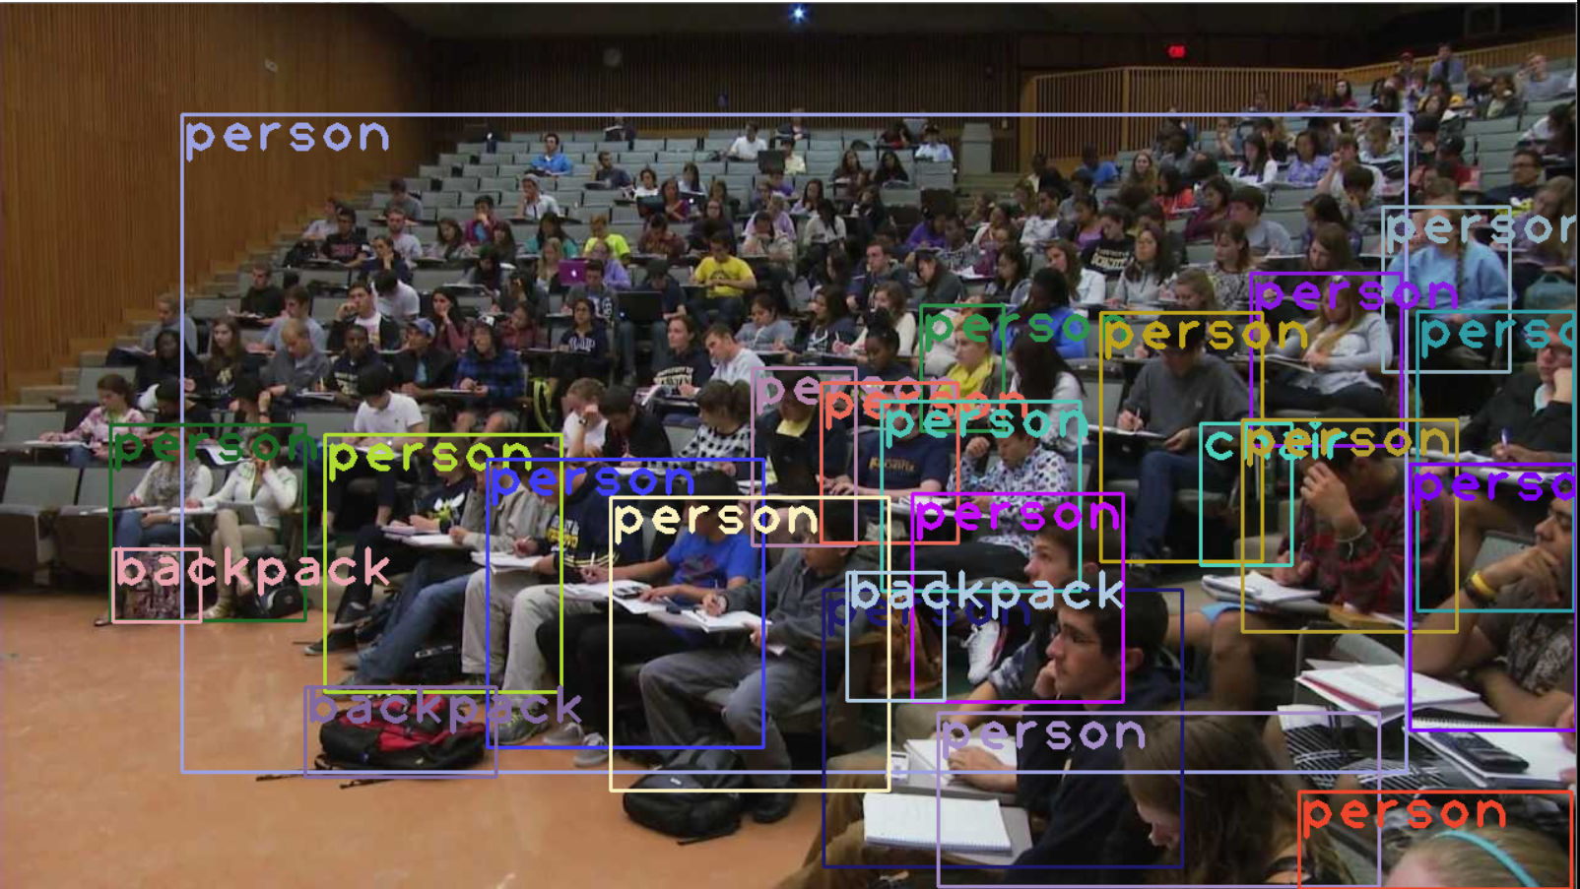
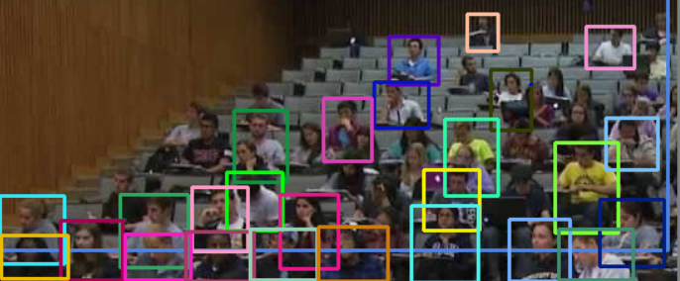
Demonstration of Image Splitting
Angela

Slide 13
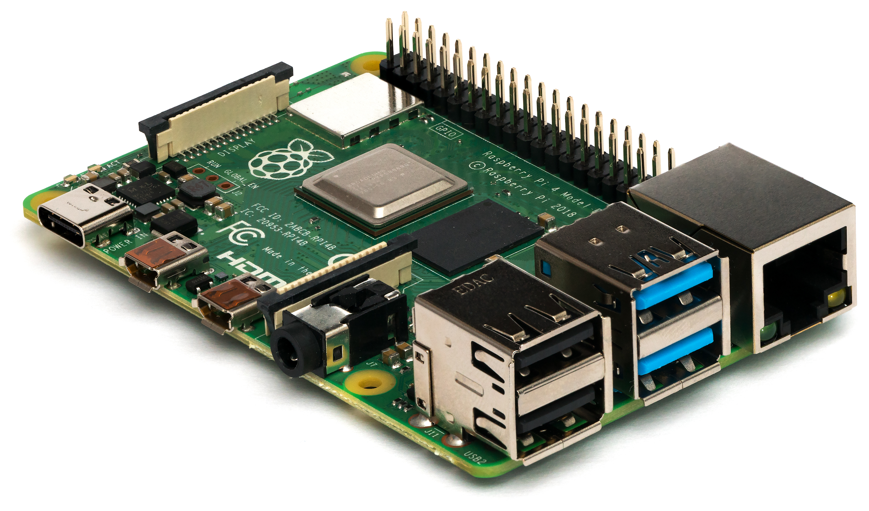
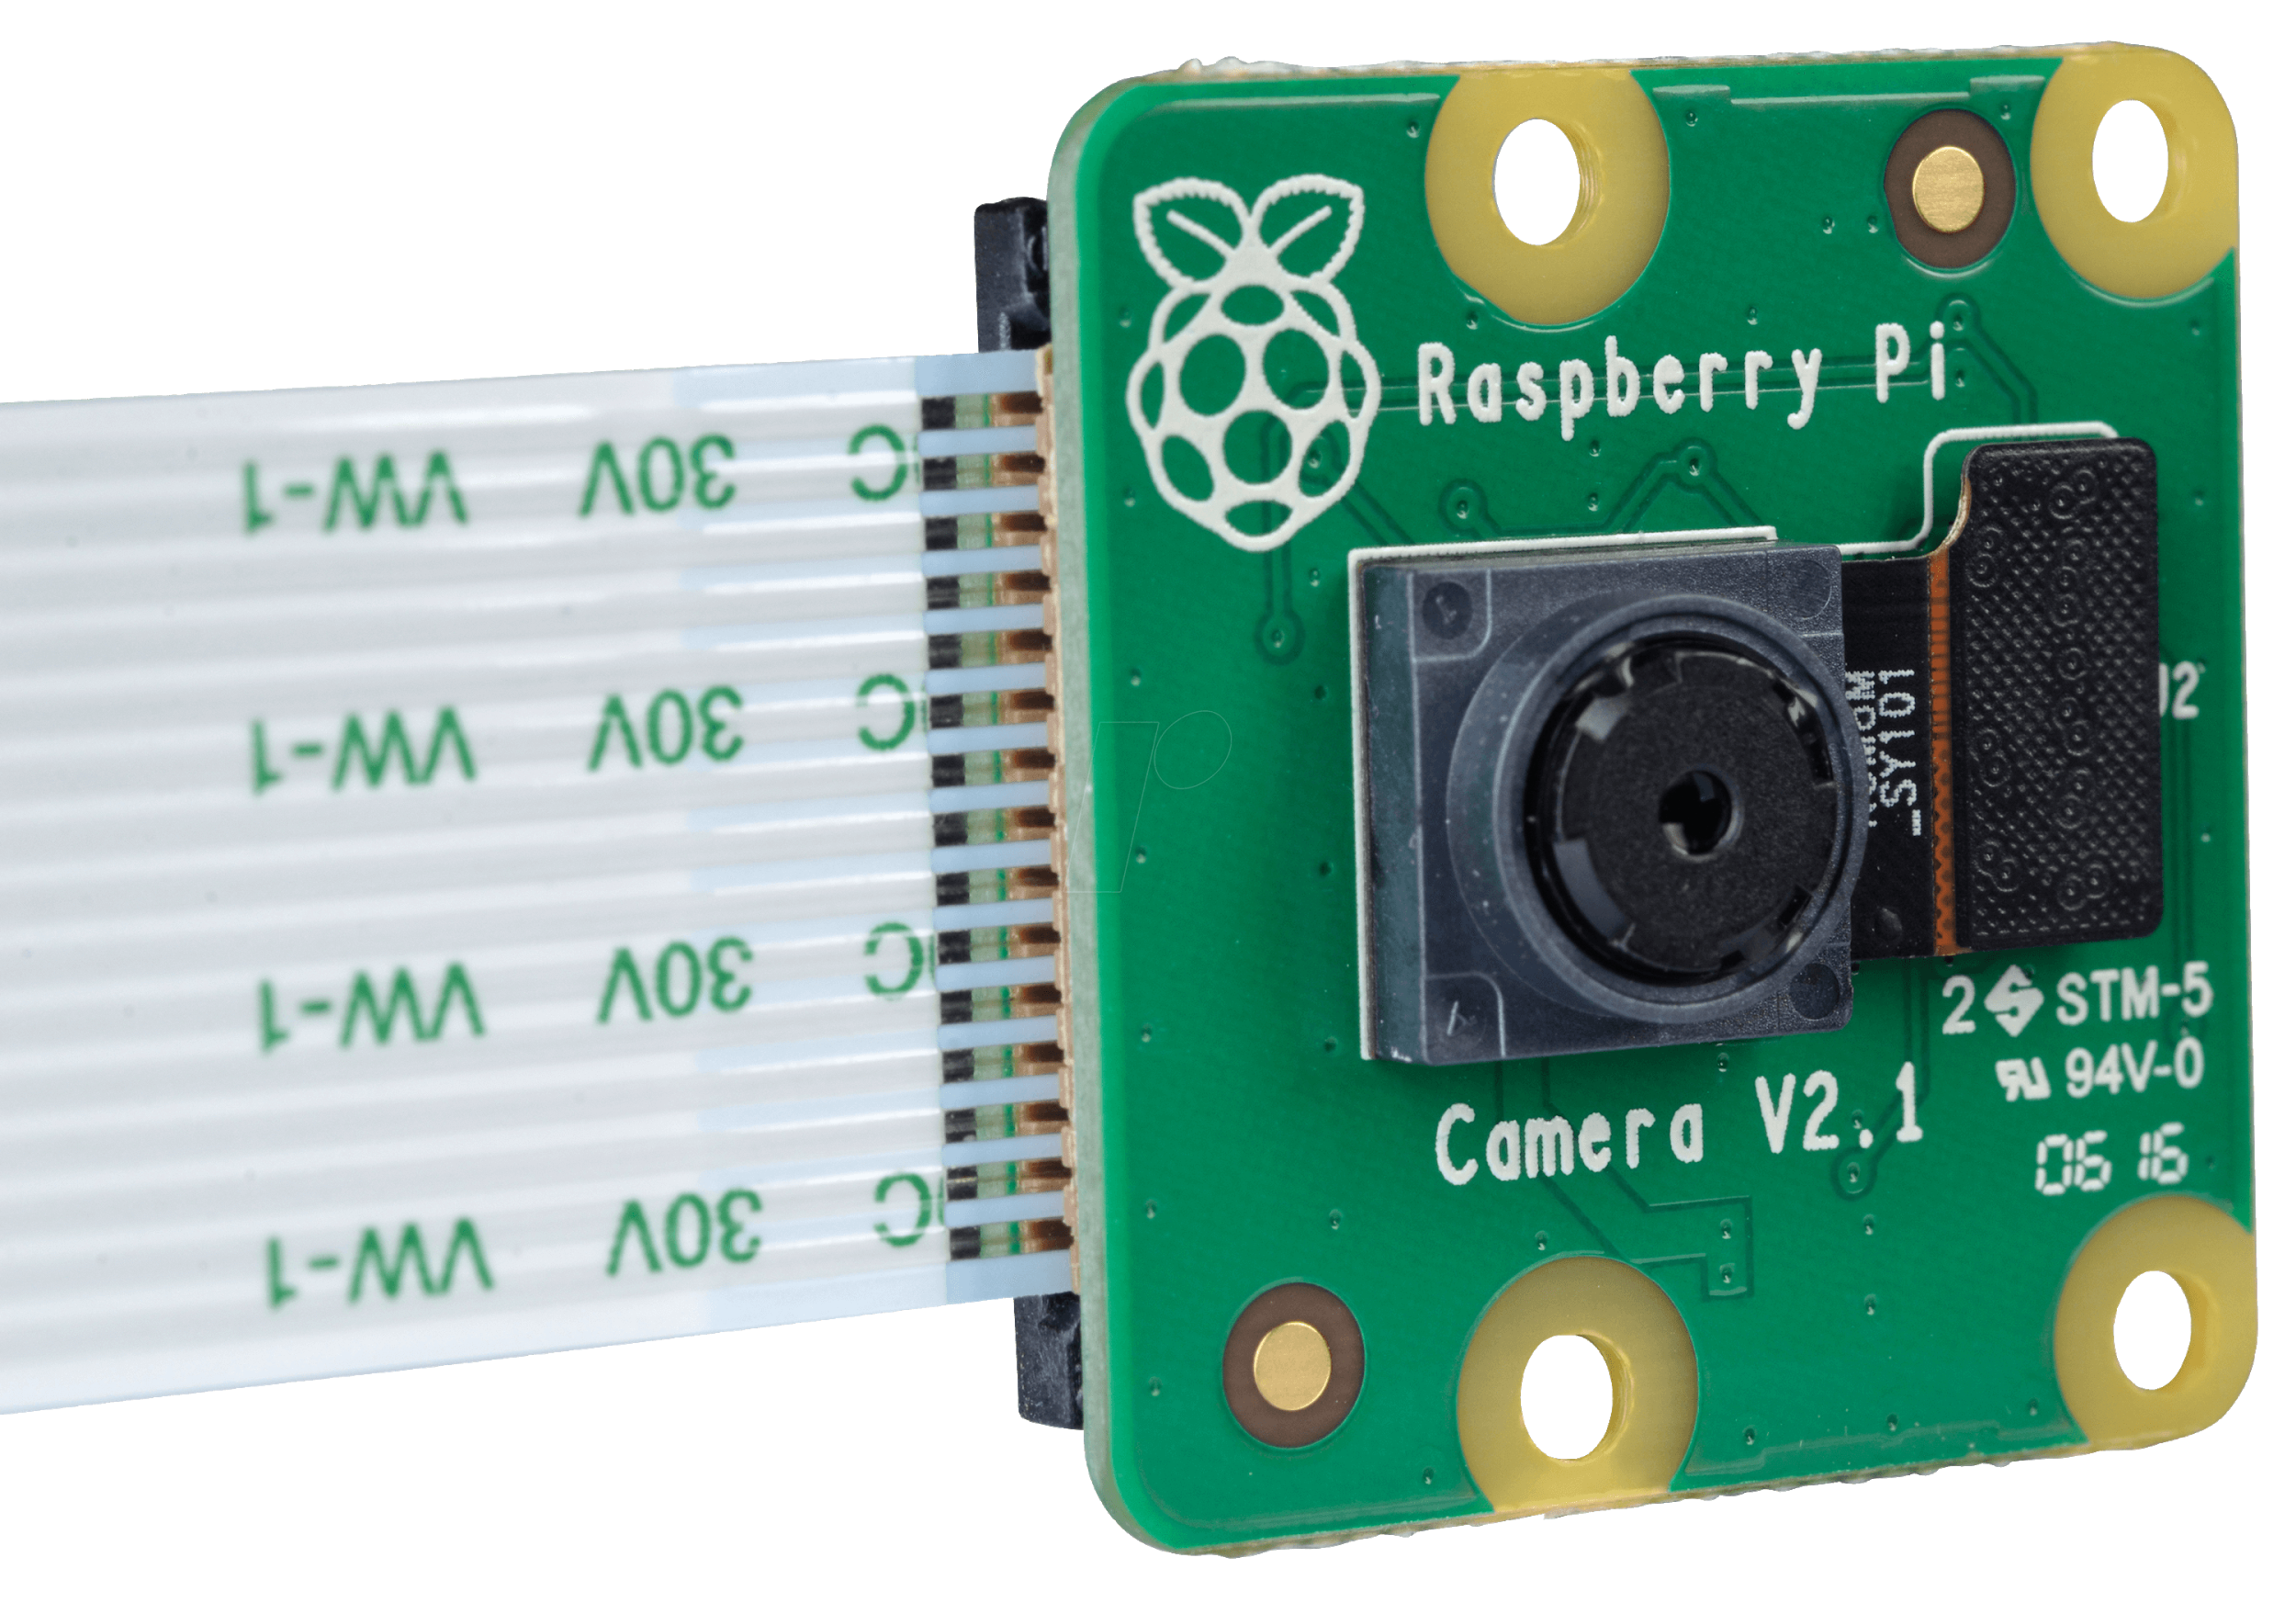
Hardware
The baseline model is the Raspberry Pi 4. Cost = $50
The camera we will used is Raspberry Pi Camera V2. It is 8MP and can take photos at a resolution of 3280 x 2464 pixels. Cost = $30
If software works well on the Raspberry Pi, we will test with the Pi Zero W model. This can reduce total costs by $30
Brandon
Notes:
Brandon Johnson

Slide 14
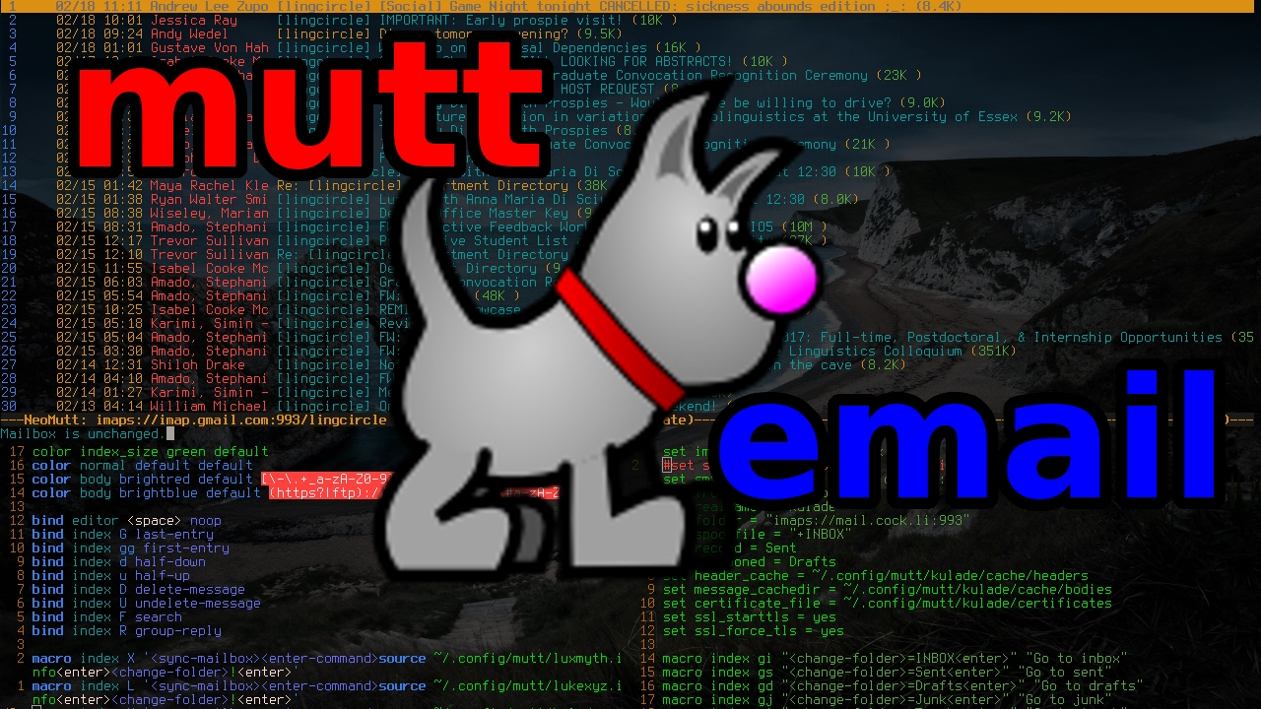
Sending Results to the Instructor & Scheduling (Implemented next semester)
The results will be in an excel file and sent to the instructor after every class period
Will use Mutt, a CLI email client, to send emails from the Pi
Tasks will be scheduled with Cron jobs. Tasks will include: taking pictures during class time, calculating results, emailing results, and deleting old pictures
Brandon
Notes:
Brandon Johnson

Slide 15
Milestones
Software
Student Detection
Detect Using Yolov3
Seating Chart Submission
Interface for Professors to enter team-based seating charts and schedule attendance capture time
Attendance Mapping
Determining Attendances and Absences
Hardware
Raspberry Pi Configuration
Network Setup and Dependencies
Attendance Scheduler
Capture the image of the classroom based on the submitted capture time
System Mount
How the system will sit in the classroom
Email Server
Using mutt to send the report to professors
Nathan

Slide 16
Project Development Plan
Our original Gantt Chart created for Design Doc v2
Updated Gantt Chart with the work we’ve done since going online.
Nathan
Notes:
Nathan Oran

Slide 17
Impact of COVID-19
We have not completed our Major Technical Goals for the Semester
The Entirety of our Hardware Development put on hold
Our Raspberry Pi needed to be connected to the ISU network to connect with our database and send emails
Yolo Trained is also on hold
Without access to the classrooms, the ATAT will not be able to learn the layout of the rooms
It’s difficult to find clean images of team-based learning environments for Yolo development
Nathan
Notes:
Nathan Oran

Slide 18
Current Progress
Completed
Researched Available Technology
Committed To Our Design
Studied Python
Began Testing Yolo
In Progress
Developing Seating Chart Mapping Algorithm
Developing System to Improve Accuracy of Yolo for classroom images
Nathan
Notes:
Nathan Oran

Slide 19
Questions?

